Slide 1
Classes
“Programs must be written for people to read, and only incidentally for machines to execute.”
– H. Ableson & G. Sussman “The Structure and Interpretation of Computer Programs”

Slide 2
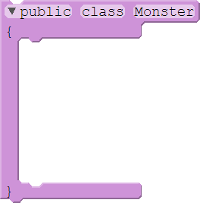

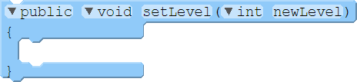

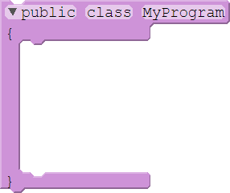
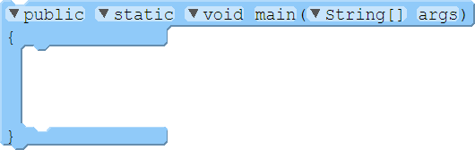


Basics of Classes
A class is a design for an object with attributes (variables) and methods (functions):
01 02 03 04 05 06 07 08 09 10
public class Monster
{
private int level = 0;
public String name = "Some Monster";
public void setLevel(int newLevel)
{
level = newLevel;
}
}
STACK
MyProgram.main()
args
pika
Monster.java
Monster.setLevel()
newLevel 10
01 02 03 04 05 06 07 08 09
public class MyProgram
{
public static void main(String[] args)
{
Monster pika = new Monster();
pika.name = "ChuChu";
pika.setLevel(10);
}
}
level
0
10
name
ChuChu
MyProgram.java
HEAP

Slide 3
Basics of Classes
A class is a design for an object with attributes (variables) and methods (functions):
01 02 03 04 05 06 07 08 09 10
public class Monster
{
private int level = 0;
public String name = "Some Monster";
public void setLevel(int newLevel)
{
level = newLevel;
}
}
STACK
MyProgram.main()
args
pika
Monster.java
Monster.setLevel()
newLevel 10
01 02 03 04 05 06 07 08 09
public class MyProgram
{
public static void main(String[] args)
{
Monster pika = new Monster();
pika.name = "ChuChu";
pika.setLevel(10);
}
}
level
0
10
name
ChuChu
MyProgram.java
HEAP

Slide 4
Basics of Classes
A class is a design for an object with attributes (variables) and methods (functions):
01 02 03 04 05 06 07 08 09 10
public class Monster
{
private int level = 0;
public String name = "Some Monster";
public void setLevel(int newLevel)
{
level = newLevel;
}
}
STACK
MyProgram.main()
args
pika
Monster.java
Monster.setLevel()
newLevel 10
01 02 03 04 05 06 07 08 09
public class MyProgram
{
public static void main(String[] args)
{
Monster pika = new Monster();
pika.name = "ChuChu";
pika.setLevel(10);
}
}
level
0
10
name
ChuChu
MyProgram.java
HEAP

Slide 5
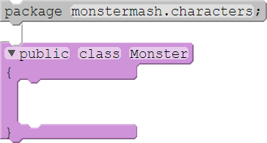
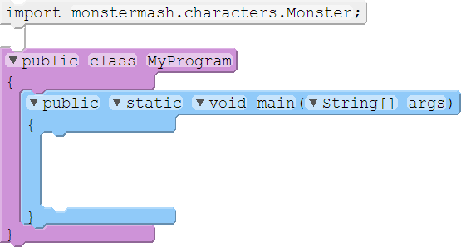



Access Modifiers
We can set the access level of classes, attributes, and methods in a declaration:
01 02 03 04 05 06 07
package monstermash.characters;
public class Monster
{
private int level = 0;
public String name = "Some Monster";
}
01 02 03 04 05 06 07 08 09 10 11
import monstermash.characters.Monster;
public class MyProgram
{
public static void main(String[] args)
{
Monster pika = new Monster();
pika.name = "ChuChu";
pika.level = 10;
}
}
Monster.java
MonsterProgram.java
Modifier | Meaning
private | Class-only access
[none] | Package access
protected | Subclass access*
public | Open access
Does not compile!

Slide 6
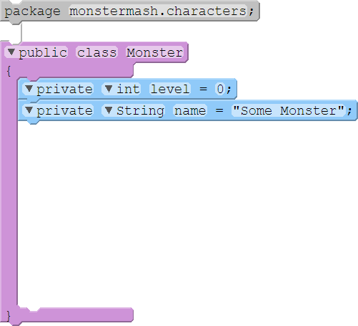
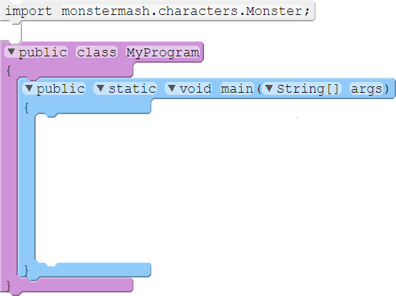
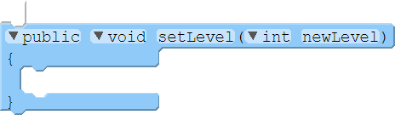


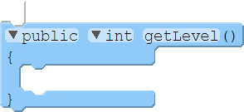

Accessors and Mutators
To encapsulate our functionality, we use accessors (“getters”) and mutators (“setters”):
01 02 03 04 05 06 07 08 09 10 11 12 13 14 15 16 17
package monstermash.characters;
public class Monster
{
private int level = 0;
private String name = "Some Monster";
public void setLevel(int newLevel)
{
level = newLevel;
}
public int getLevel()
{
return level;
}
}
01 02 03 04 05 06 07 08 09 10 11 12 13 14 15
import monstermash.characters.Monster;
public class MyProgram
{
public static void main(String[] args)
{
Monster pika = new Monster();
System.out.print("Start level: ");
System.out.println(pika.getLevel());
pika.setLevel(10);
System.out.print(“New level: ");
System.out.println(pika.getLevel());
}
}
MyProgram.java
Monster.java
Output
0
Start level:
New level:
10

Slide 7
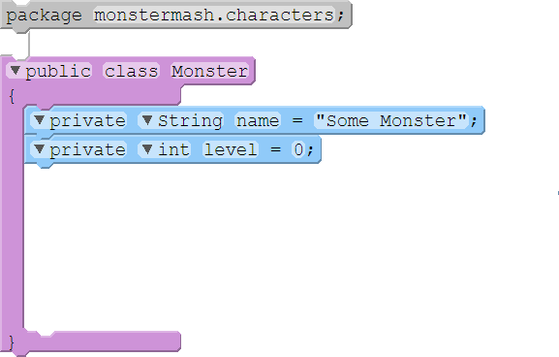
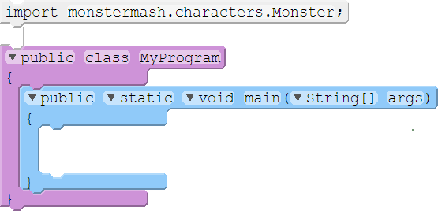
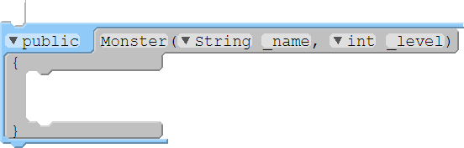

Constructors
We can initialize a new object using a constructor:
01 02 03 04 05 06 07 08 09 10 11 12 13
package monstermash.characters;
public class Monster
{
private String name = "Some Monster";
private int level = 0;
public Monster(String _name, int _level)
{
name = _name;
level = _level;
}
}
01 02 03 04 05 06 07 08 09 10
import monstermash.characters.Monster;
public class MyProgram
{
public static void main(String[] args)
{
Monster pika = new Monster("Chu", 10);
Monster puff = new Monster();
}
}
MyProgram.java
Monster.java
Does not compile!

Slide 8
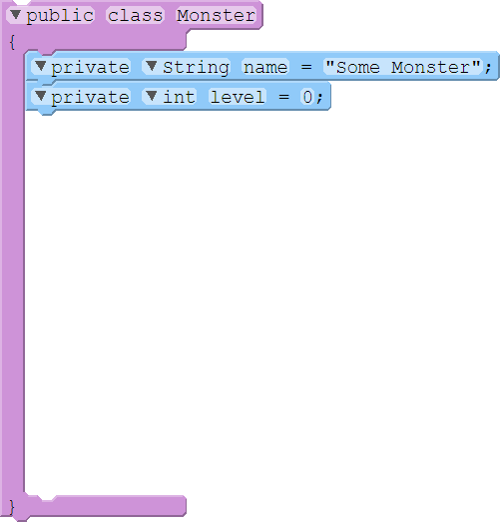
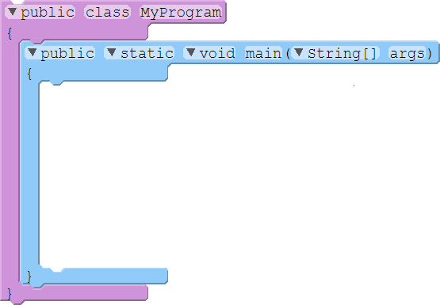


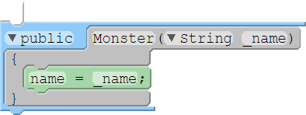


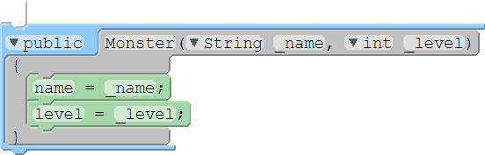
Overloaded Constructors
We can overload the constructor to provide multiple ways to create an object:
01 02 03 04 05 06 07 08 09 10 11 12 13 14 15 16 17 18
public class Monster
{
private String name = "Some Monster";
private int level = 0;
public Monster() { }
public Monster(String _name)
{
name = _name;
}
public Monster(String _name, int _level)
{
name = _name;
level = _level;
}
}
01 02 03 04 05 06 07 08 09 10 11 12 13 14
public class MyProgram
{
public static void main(String[] args)
{
// Default constructor (no params)
Monster rando = new Monster();
// One-parameter constructor
Monster puff = new Monster("Jiggle");
// Two-parameter constructor
Monster pika = new Monster("Chu", 10);
}
}
MyProgram.java
Monster.java
Other methods can be overloaded too!

Slide 9
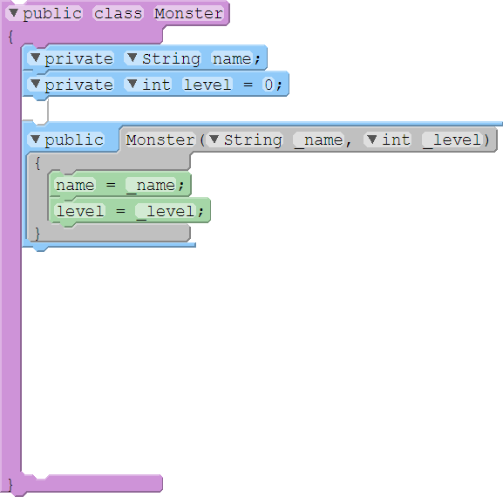
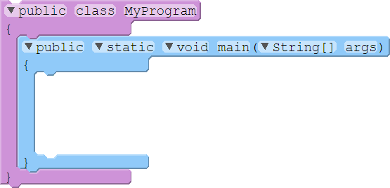


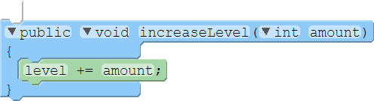
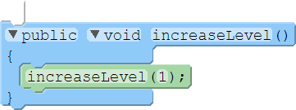
Overloading Methods
Methods can be overloaded if the parameters are varied:
01 02 03 04 05 06 07 08 09 10 11 12 13 14 15 16 17 18 19 20 21
public class Monster
{
private String name;
private int level = 0;
public Monster(String _name, int _level)
{
name = _name;
level = _level;
}
public void increaseLevel(int amount)
{
level += amount;
}
public void increaseLevel()
{
increaseLevel(1);
}
}
01 02 03 04 05 06 07 08 09 10
public class MyProgram
{
public static void main(String[] args)
{
Monster pika = new Monster("Chu", 10);
pika.increaseLevel();
pika.increaseLevel(10);
}
}
MyProgram.java
Monster.java
pika
level
0
10
11
21
name
Chu
HEAP

Slide 10
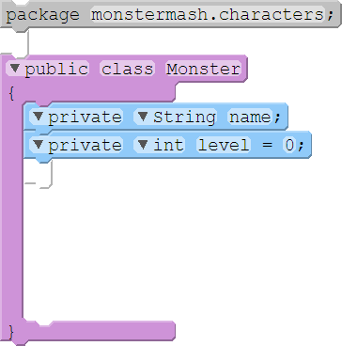
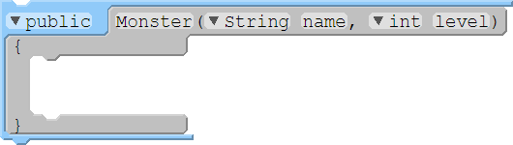


Self Reference (“This”)
We can distinguish variables within the class with the this identifier:
01 02 03 04 05 06 07 08 09 10 11 12 13
package monstermash.characters;
public class Monster
{
private String name;
private int level = 0;
public Monster(String name, int level)
{
this.name = name;
this.level = level;
}
}
Monster.java

Slide 11
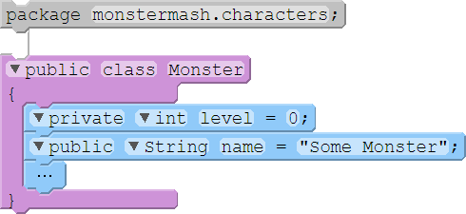
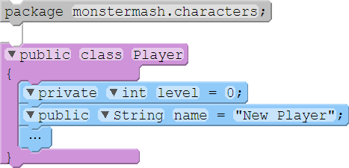
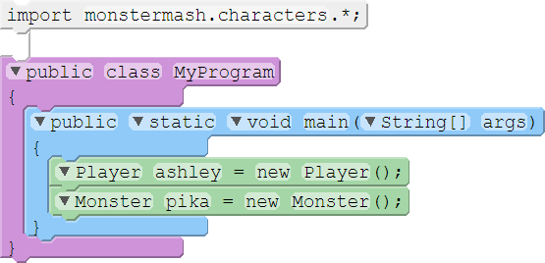
Class Packages
We can group classes together into packages:
01 02 03 04 05 06 07 08
package monstermash.characters;
public class Monster
{
private int level = 0;
public String name = “Some Monster";
…
}
01 02 03 04 05 06 07 08
package monstermash.characters;
public class Player
{
private int level = 0;
public String name = "New Player";
…
}
Monster.java
Player.java
01 02 03 04 05 06 07 08 09 10
import monstermash.characters.*;
public class MyProgram
{
public static void main(String[] args)
{
Player ashley = new Player();
Monster pika = new Monster();
}
}
src
monstermash
characters
MyProgram.java
Monster.java
Player.java
MyProgram.java

Slide 12
Passing Objects as Arguments
Monster obj = new Monster( );
int a = 10;
Stack Memory
a=10
main
obj = #AF
Heap Memory
#AF
name =“”
level = 0

Slide 13
Passing Objects as Arguments
The value of the reference variable is an address or reference to the object in memory.
A copy of the object is not passed, just a pointer to the object.
Heap Memory
#AF
main()
{
Monster obj = new Monster( );
int a = 10;
}
…
name =“”
level = 0
Stack Memory
objP
someOtherMethod
aP=10
someMethod
a=10
main
obj = #AF

Slide 14
Passing Objects as Arguments
The value of the reference variable is an address or reference to the object in memory.
A copy of the object is not passed, just a pointer to the object.
Heap Memory
#AF
main()
{
Monster obj = new Monster( );
int a = 10;
someMethod(a); //primitive data type
}
…
public void static someMethod(int aP){ … }
name =“”
level = 0
Stack Memory
objP
someOtherMethod
aP=10
someMethod
a=10
main
obj = #AF

Slide 15
Passing Objects as Arguments
The value of the reference variable is an address or reference to the object in memory.
A copy of the object is not passed, just a pointer to the object.
Java passes all arguments by value.
Heap Memory
#AF
main()
{
Monster obj = new Monster( );
int a = 10;
someMethod(a); //primitive data type
someOtherMethod(obj); // reference data type
}
…
public void static someMethod(int aP){ … }
public void static someOtherMethod(Monster objP){ … }
name =“”
level = 0
Stack Memory
objP = #AF
someOtherMethod
aP=10
someMethod
a=10
main
obj = #AF

Slide 16
Passing Objects as Arguments
The value of the reference variable is an address or reference to the object in memory.
A copy of the object is not passed, just a pointer to the object.
When a method receives a reference variable as an argument, it is possible for the method to modify the contents of the object referenced by the variable.

Slide 17
Passing Objects as Arguments
01 02 03 04 05 06 07 08 09 10 11 12 13 14 15 1617 18 19 20
public class PassObject
{
public static void main(String[] args)
{
Rectangle box = new Rectangle(12.0, 5.0);
System.out.println("Contents of the box object: ");
System.out.println("Length: " + box.getLength() +
“ Width: " + box.getWidth());
changeRectangle(box);
System.out.println("Contents of the box object: ");
System.out.println("Length: " + box.getLength() +
“ Width: " + box.getWidth());
}
public static void changeRectangle(Rectangle r)
{
r.setLength(0.0);
r.setWidth(0.0);
}
}
box
length
12
0
width
5
0
r

Slide 18
Passing Objects as Arguments
01 02 03 04 05 06 07 08 09 10 11 12 13 14 15 1617 18 19 20
public class PassObject
{
public static void main(String[] args)
{
Rectangle box = new Rectangle(12.0, 5.0);
System.out.println("Contents of the box object: ");
System.out.println("Length: " + box.getLength() +
“ Width: " + box.getWidth());
changeRectangle(box);
System.out.println("Contents of the box object: ");
System.out.println("Length: " + box.getLength() +
“ Width: " + box.getWidth());
}
public static void changeRectangle(Rectangle r)
{
r.setLength(0.0);
r.setWidth(0.0);
}
}
box
length
12
0
width
5
0
r
Output:
Contents of the box object:
Length: 12.0 Width: 5.0
Contents of the box object:
Length: 0.0 Width: 0.0
Notes:
public class Main
{
public static void main(String[] args)
{
Rectangle box = new Rectangle(12.0, 5.0);
System.out.println("Contents of the box object: ");
System.out.println("Length: " + box.getLength() +
" Width: " + box.getWidth());
changeRectangle(box);
System.out.println("Contents of the box object: ");
System.out.println("Length: " + box.getLength() +
" Width: " + box.getWidth());
}
public static void changeRectangle(Rectangle r)
{
r.setLength(0.0);
r.setWidth(0.0);
}
}
class Rectangle
{
public double length, width;
public Rectangle(double l, double w)
{
length=l;
width=w;
}
public double getWidth(){
return width;
}
public double getLength(){
return length;
}
public void setLength(double l){
length=l;
}
public void setWidth(double w){
width=w;
}
}

Slide 19
Test your understanding
01 02 03 04 05 06 07 08 09 10 11 12 13 14 15 1617
public class PollQuestions
{
public static void main(String[] args)
{
Walrus walrus = new Walrus(3500, 10.5);
int x = 9;
doStuff(walrus, x);
System.out.println(walrus);
System.out.prtinln(x);
}
public static void doStuff(Walrus W，int x)
{
W.weight = W.weight – 100;
x = x – 5;
}
}
Does the call to doStuff(walrus, x) have an effect on walrus and/or main’s x?
Neither will change.
walrus will lose 100lbs, but main’s x will not change
walrus will not change, but main’s x will decrease by 5.
Both will decrease.

Slide 20
The toString Method
The toString method of a class can be called explicitly:
Rectangle box = new Rectangle(12.0, 5.0);
System.out.println(box.toString());
However, the toString method does not have to be called explicitly but is called implicitly whenever you pass an object of the class to println or print.
Rectangle box = new Rectangle(12.0, 5.0); System.out.println(box);

Slide 21
The toString Method
The toString method is also called implicitly whenever you concatenate an object of the class with a string.
Rectangle box = new Rectangle(12.0, 5.0);
System.out.println(“I am the box:” + box);
All objects have a toString method that returns the class name and a hash of the memory address of the object.
We can override the default method with our own to print out more useful information.

Slide 22
The equals Method
When the == operator is used with reference variables, the memory address of the objects are compared.
The contents of the objects are not compared.
All objects have an equals method.
The default operation of the equals method is to compare memory addresses of the objects (just like the == operator).

Slide 23
Static Class Members
A static variable or static method exists in a class and outside of any particular object:
01 02 03 04 05 06 07 08 09 10 11 12 13 14 15 1617 18 19 20
public class Morty
{
public static final maxLevel = 100;
private static int mortyCount = 0;
private String name;
private int level = 0;
public Morty(String _name, int _level)
{
name = _name;
level = _level;
mortyCount++;
}
public static int getCount()
{
return mortyCount;
}
}
Monster.java
Countable.java
StaticDemo.java

Slide 24
Nested Classes
At times, it may be valuable to nest one class inside of another.
Nested class cannot access non-static members of the outer class
01 02 03 04 05 06 07 08 09 10 11 12 13 14 15 16 17 18 19
public class Monster
{
public static class Attack
{
String name = "Some attack";
int damage = 1;
public Attack(String name, int damage) {…}
public String getName() {…}
public int getDamage() {…}
}
private String name;
private int level = 0;
private Attack attack = new Attack();
public Monster(String name, int level) {…}
public Attack getAttack() {…}
public void setAttack(Attack _attack) {…}
}
01 02 03 04 05 06 07 08 09 10 11 12 13 14 15 16
public class MyProgram
{
public static void main(String[] args)
{
Monster.Attack crush;
crush = new Monster.Attack("Crush", 10);
Monster chu = new Monster("Pika", 2);
chu.setAttack(crush);
String attack = chu.getAttack().getName();
System.out.print("New attack: ");
System.out.println(attack);
}
}
MyProgram.java
Monster.java
Output
Crush
New Attack:

Slide 25
Inner Classes
If we want nested classes tied to a particular object, we can use inner classes:
01 02 03 04 05 06 07 08 09 10 11 12 13 14 15 16 17
public class Monster
{
public class Attack
{
String name = "Some attack";
int damage = 1;
public Attack(String name, int damage) {…}
public String getParentName()
{
return Monster.this.name;
}
}
private String name;
private int level = 0;
public Monster(String name, int level) {…}
}
01 02 03 04 05 06 07 08 09 10 11 12 13 14 15
public class MyProgram
{
public static void main(String[] args)
{
Monster chu = new Monster("Pika", 2);
Monster.Attack crush;
crush = chu.new Attack("Crush", 10);
String name = crush.getParentName();
System.out.print(“Parent Name: ");
System.out.println(name);
}
}
MyProgram.java
Monster.java
Output
Pika
Parent Name:
Inner class objects are tied to the parent object and can access their private elements.

Slide 26
Private Nested Classes
If we want a class just for organization, we can use a private nested class:
01 02 03 04 05 06 07 08 09 10 11 12 13 14 15 16 17 18 19 20
public class Monster
{
private static class Attack
{
String name = "Some attack";
int damage = 1;
private Attack(String name, int level) {…}
}
private String name;
private int level = 0;
private Attack attack = null;
public Monster(String name, int level) {…}
public String getAttack() { return attack.name; }
public void newAttack(String name, int damage)
{
attack = new Attack(name, damage);
}
}
01 02 03 04 05 06 07 08 09 10 11 12 13 14
public class MyProgram
{
public static void main(String[] args)
{
Monster chu = new Monster("Pika", 2);
chu.newAttack("Crush", 10);
String name = chu.getAttack();
System.out.print("Attack Name: ");
System.out.println(name);
}
}
MyProgram.java
Monster.java
Output
Crush
Attack Name:

Slide 27
Local Classes
If we need a class just within a particular method, we can create a local class:
01 02 03 04 05 06 07 08 09 10 11 12 13 14 15 16 17
public class MyProgram
{
public static void main(String[] args)
{
class Monster
{
String name;
int level;
Monster(String name, int level) {…}
}
Monster chu = new Monster("Pika", 2);
Monster jig = new Monster("Puff", 5);
System.out.println("Created " + chu.name + " with level " + chu.level);
System.out.println("Created " + jig.name + " with level " + jig.level);
}
}
MyProgram.java
Output
Created Pika with level 2
Created Puff with level 5

Slide 28
Static Initialization
We can execute code for a class – outside of a method – via static initialization:
01 02 03 04 05 06 07 08 09 1011 12 13 14
public class Monster
{
private String name;
private int level = 0;
public static final MAX_LEVEL;
static
{
MAX_LEVEL = 100;
}
public Monster(String name, int level) {…}
public int attack(Character enemy) {…}
}
Monster.java
The static initialization block is run once when the class is first loaded.

Slide 29
Instance Initialization
We can do the same for each object via instance initialization:
01 02 03 04 05 06 07 08 09
public class Monster extends Character
{
private String name;
private int level = 0;
{
name = "Some Monster";
}
public Monster(String name, int level) {…}
public int attack(Character enemy) {…}
}
Monster.java
The instance initialization block is copied into every constructor by the compiler.

Slide 30
QUESTIONS

